Slide 1
Marketing Lecture # 17 Muhammad asad Instructor department of computer science

Slide 2
Key Learning Point :-
- Discussion about corporate level strategies

Slide 3
STABILITY STRATEGIES
A stability strategy is a corporate strategy where a company concentrates on maintaining its current market position --- Focuses on its existing product and market.
Generally, the stability strategy is adopted by the organizations that are risk averse --- Usually, if the market conditions are not favorable, and the company is satisfied with its performance --- Then it will not make any significant changes in its business operations.

Slide 4
DOES A COMPANY STOP GROWING?
The company try to improve its current product and services only.
Focuses only on the incremental improvement by merely changing one or more of its business operations --- In the perspective of customer operations and technology alternatives, either individually or collectively.

Slide 5
NO-CHANGE STABILITY STRATEGY
It is a conscious decision to do nothing new --- and --- Continuing with the existing business operations.
When a company has a stable internal and external environment (no threats from the competitors, no economic disturbances, no change in the strengths and weaknesses) the company will continue with its present strategy.

Slide 6
PROFIT STABILITY STRATEGY
When an organization aims to maintain the profit to tackle the problems --- The problems could be the economic recession or inflation, industry downturn, worst market conditions, competitive pressure, government policies and etc.
Due to lower profitability, the company may cut costs, reduce investments, raise prices, or adopt any methods to overcome the temporary difficulties.
Profit strategy is a situation in which old and outdated product or technology is being replaced by a new one (Operational efficiency) --- Profit strategy does not require new investment, the same technology is followed, at least partially with new technological domains.

Slide 7
FOR EXAMPLE
A consumer electronics company focuses on providing better after-sales services to current customers --- not on acquiring new customers.
The biscuit manufacturing company improves its existing technology to have the efficient productivity.
The companies are not making any significant changes in their operations, they are serving the same customers with the same products using the same technology.

Slide 8
PAUSE / PROCEED WITH CAUTION STABILITY STRATEGY when an organization wait and look at the market conditions before launching the full-fledged grand strategy --- OR --- A deliberate action taken by the organization to postpone the strategic action till the best opportunity knocks at the door. Thus, waiting for the right strategy for the right time.
NOTE
Profit strategy and Pause / Proceed with Caution Strategy are temporary stability strategies.

Slide 9
RETRENCHMENT RENEWAL STRATEGIES
Use for shrinking to survive --- Companies withdrawing from some geographical markets or discontinuing product lines to reduce expenses --- It involve cutting down the expenditure, So the company becomes financially stronger and more stable.
Retrenchment strategy is a short-run renewal strategy used for minor performance problems --- Used when an organization seeks to reverse a decline in performance --- The main focus of such a strategy is to increase operating efficiencies and improve cash flow.

Slide 10
TURNAROUND RENEWAL STRATEGIES use for same purpose shrinking to survive --- When an organization’s problems are more serious and more drastic action required.
Retrenchment strategy is a long-term strategic plan for renewal used for major performance problems.
NOTE
Managers do two things for both renewal strategies --- Cut costs and restructure organizational operations --- For the purpose of survival and pivot to growth --- However, in a turnaround strategy these measures are more extensive than in a retrenchment strategy.

Slide 11
HOW ARE CORPORATE STRATEGIES MANAGED?
When an organization’s --- Corporate strategy covers a number of businesses, managers can manage, this collection or portfolio of businesses using a tool called a corporate portfolio matrix.
This matrix provides a framework for understanding diverse businesses and helps managers establish priorities for allocating resources.

Slide 12
UNILEVER
Unilever is a British-Dutch multinational consumer goods company, headquartered in London, United Kingdom and Rotterdam, The Netherlands --- Unilever owns over 400 brands.
https://en.wikipedia.org/wiki/Unilever
PROCTER & GAMBLE (P&G)
The Procter & Gamble Company (P&G) is an American multinational consumer goods corporation headquartered in Cincinnati, Ohio, founded in 1837 by William Procter and James Gamble --- Procter & Gamble owns over 65 brands.
https://en.wikipedia.org/wiki/Procter_%26_Gamble

Slide 13
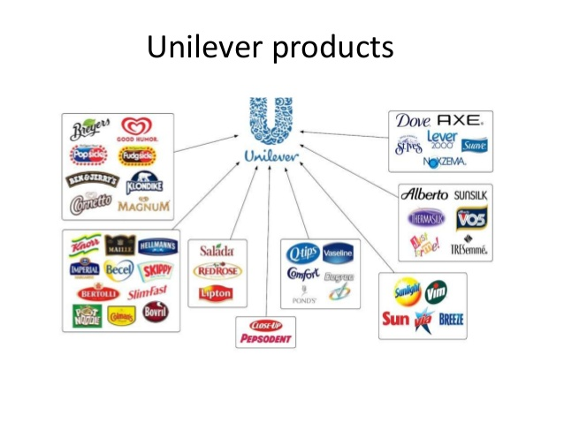

Slide 14
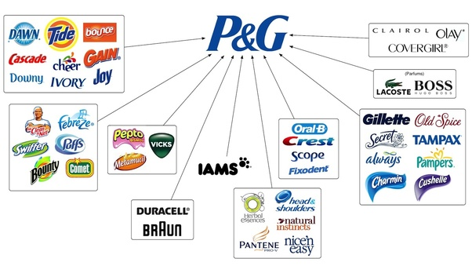

Slide 15
On August 1, 2014, P&G announced it was streamlining the company, dropping and selling off around 100 brands from its product portfolio in order to focus on the remaining 65 brands --- Which produced 95% of the P&G profits.
What tool used by P&G to analyze --- To identify which ones offered high potential and which one drain on organizational resources --- Out of 100 brands ?

Slide 16

ANY QUESTION
You can contact me at: asadali@uosahiwal.edu.pk
Your query will be answered within one working day.

